Slide 1
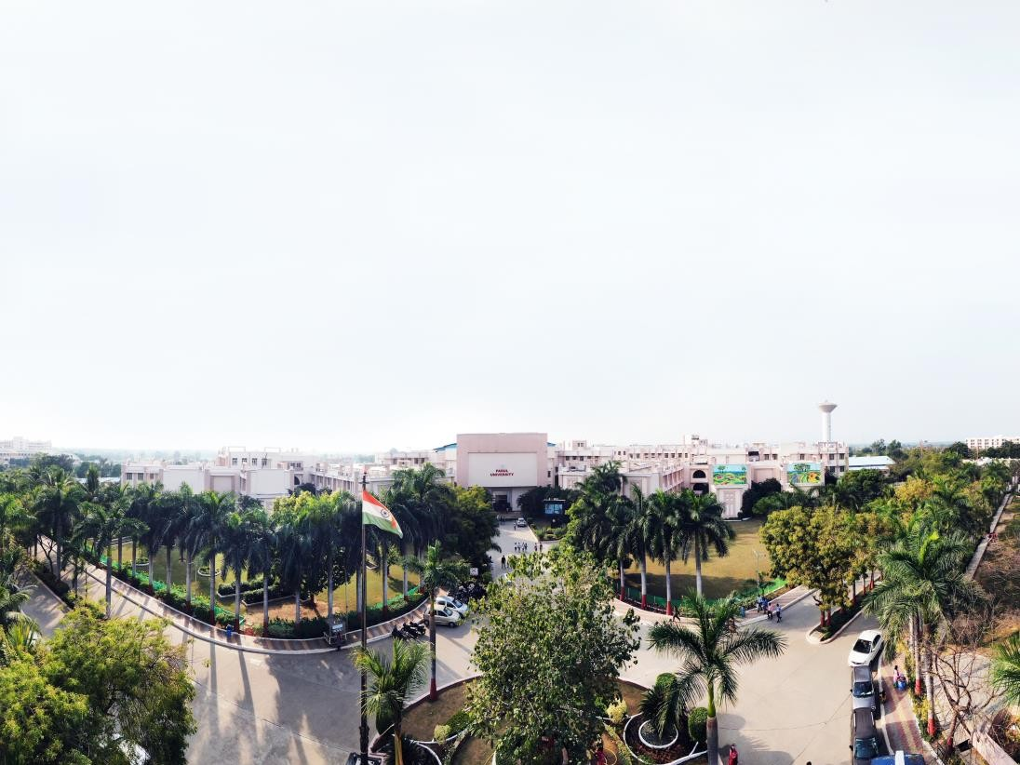


Fundamental of Programming / PROGRAMMING FOR PROBLEM SOLVING
Prof. Umang Panchal, Designation Computer Science & Engineering

Slide 2
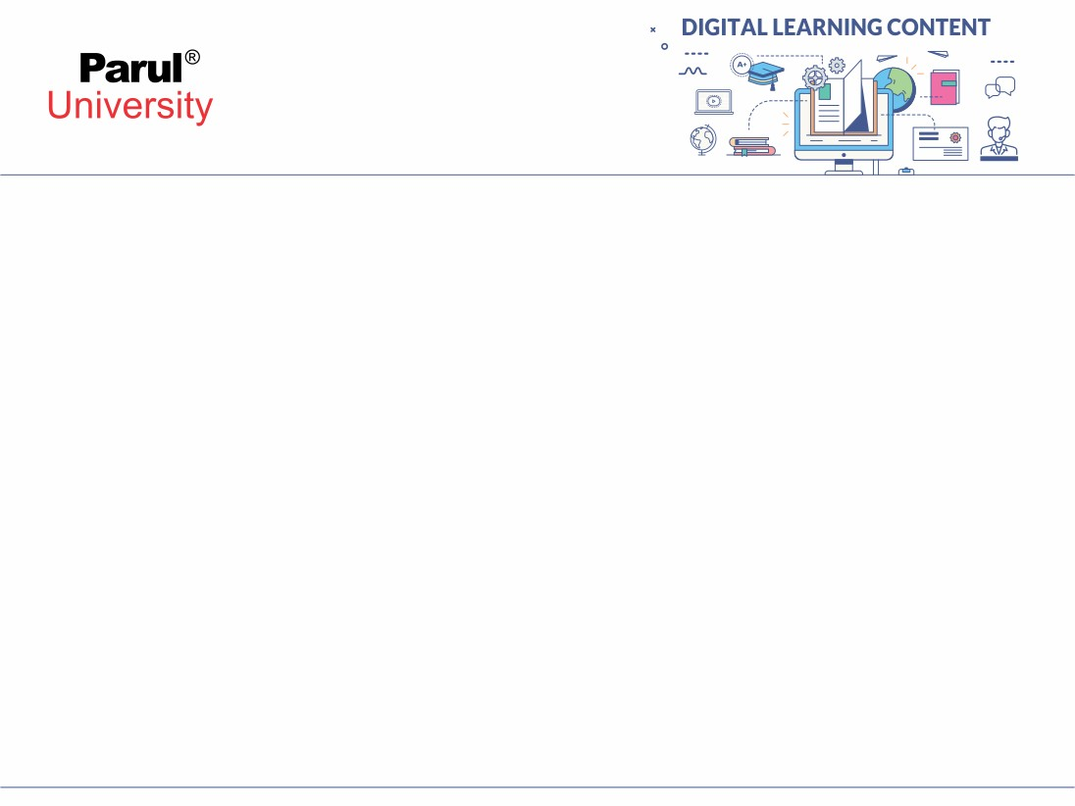

CHAPTER-1
INTRODUCTION TO C LANGUAGE

Slide 3
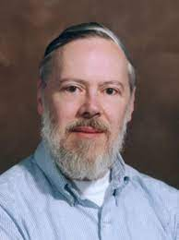
HISTORY OF C LANGUAGE
C is developed by Dennis Ritchie in the year 1972 at Bell Laboratories(USA).
It is a General- purpose, Structured, Machine Independent, Simple and Flexible programming language.
Initially, C language was developed to be used in UNIX operating system. It inherits many features of previous languages such as B and BCPL.

Slide 4
PROGRAM DEVELOPMENT STEPS
The program development steps or phases that we follow a sequence of steps to develop a program in any programming language.
Generally, the program development steps contains 6 phases, they are as follows
Requirements
Analysis
Design
Coding
Testing
Maintenance

Slide 5
FEATURES OF C LANGUAGE
Simple
Machine Independent or Portable
Mid-level programming language
structured programming language
Rich Library
Memory Management
Fast Speed
Pointers
Recursion
Extensible

Slide 6
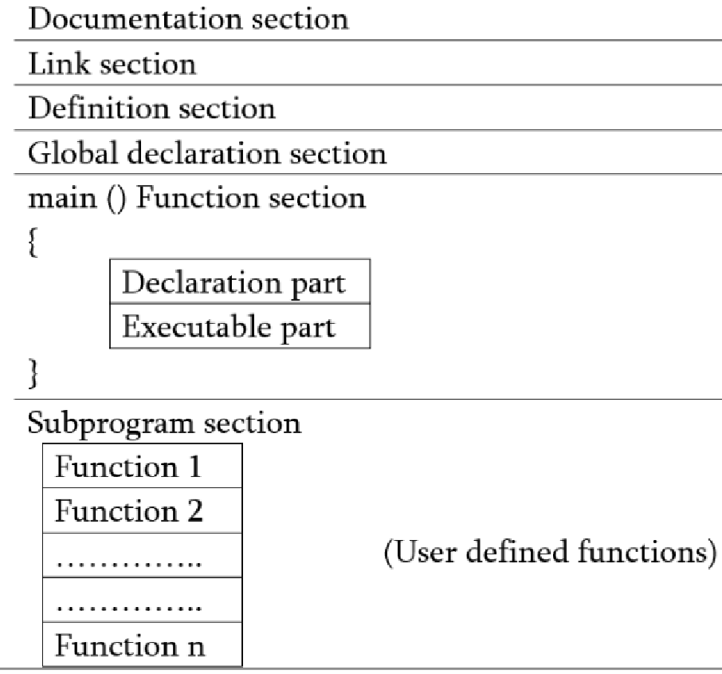
STRUCTURE OF C PROGRAM
Documentation – comments about program Link- instructions to compiler
Definition- defines all symbolic constants
Global declaration- variable that is frequently used Main()-
Declaration: all variables
Execution: programming
Subprogram- user defined functions

Slide 7
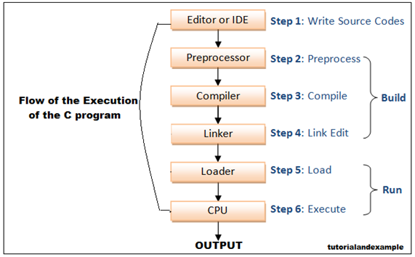
EXECUTION OF C PROGRAM

Slide 8
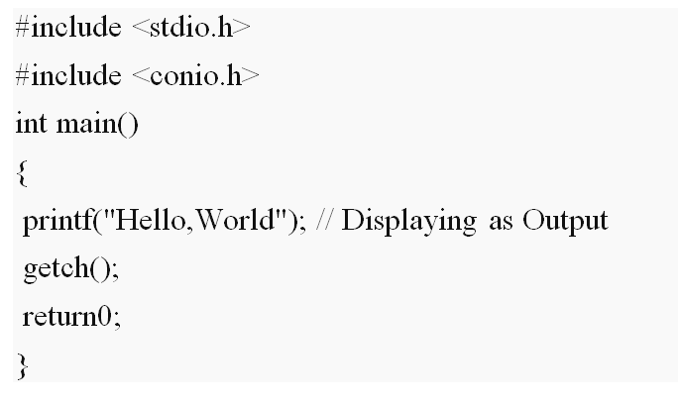
EXAMPLE

Slide 9

www.paruluniversity.ac.in

